Slide 1
Audio Gender Classification
Rashi Pachino 345174478
Noah Weiss 326876786

Slide 2
Introduction – The Challenge
What? Improve accuracy and run time of the model
How? Implementation of various algorithms (Augmentation, X-Vector, PCA)
Why? Helpful in crime analysis, healthcare systems, interactive systems
Link to our Github: https://github.com/noahweiss890/Gender-Voice-Recognition-Project

Slide 3
The Dataset – Mozilla Common Voice
Original Data:
Over 7,000 speakers
Over 1,000,000 utterences we sampled over 9 hours of audio (4,624 files)
Average of 7.15 seconds per audio file
wide range of different ethnicities, accents, and ages
Received as M4A, we convert to wav
Mozilla Common Voice:
2,705 speakers
Over 51 validated hours (63,940 audio files)
We sampled over 19 hours of audio (12, 944 audio files)
Received as Mp3, we convert to wav
Average of 5.39 seconds
Link : https://commonvoice.mozilla.org/en/datasets

Slide 4
Current Approach
Current Github: https://github.com/jim-schwoebel/voice_gender_detection
Pros: Compares various models, well written and documented, already cleaned data
Cons: accuracy could be higher, featurizes MFCC coefficients and not x-vector, little data, fatal error in code during featurization
 | Accuracy | Precision | Recall | Winning Model | Run Time
Original | 0.9140 | 0.9132 | 0.9151 | Hard Voting: Gradient Boosting, Logistic Regression, AdaBoost | 93.78 seconds
Original | 0.8841 | 0.8777 | 0.8926 | SVC | 9.17 seconds

Slide 5
Our Improvements
Augmented Data – Youtube script
Added X-Vector to features
Implemented PCA
Improved Accuracies, run time
 | Accuracy | Precision | Recall | Winning Model | Run Time
Original | 0.8841 | 0.8777 | 0.8926 | SVC | 9.17 seconds
Augmented Data | 0.8782 | 0.8796 | 0.8767 | SVC | 9.18 seconds
X-Vector | 0.9065 | 0.9155 | 0.8959 | SVC | 32.77 seconds
PCA | 0.9768 | 0.9824 | 0.9709 | SVC | 3.2131 seconds

Slide 6
Code Questions
Credit where credit is due:
X-Vector Function – Yosef
Derivative Function – Lior and Gal
Percentages helper function – Lior and Gal
Augmentation Script – Rashi
X-Vector Implementation – Noah
PCA – Rashi and Noah
Github : Jim Schwoebel

Slide 7
Algorithms – X-Vector
X-Vector
Number of features increased in training, and added on to inference
audio file embeddings from DNN
 | Accuracy | Precision | Recall | Winning Model | Run Time
Original | 0.8841 | 0.8777 | 0.8926 | SVC | 9.17 seconds
Augmented Data | 0.8782 | 0.8796 | 0.8767 | SVC | 9.18 seconds
X-Vector | 0.9065 | 0.9155 | 0.8959 | SVC | 32.77 seconds

Slide 8
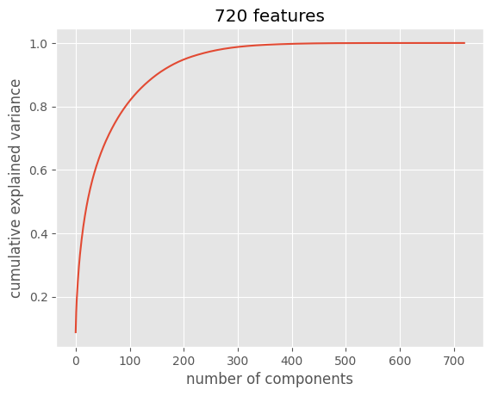
Algorithms - PCA
PCA
minimized dimensions/features (eigenvalues/eigenvectors)
Scaled first using StandardScaler
derivative algo used to determine n_components
saved PCA model used for transform in inference
 | N components | Accuracy | Precision | Recall | Model | Run time
Without PCA | ---- | 0.9065 | 0.8777 | 0.8926 | SVC | 32.77 seconds
PCA on original | 147 | 0.9772 | 0.9829 | 0.9714 | SVC | 13.26 seconds
PCA on X-Vector | 125 | 0.9765 | 0.9829 | 0.9700 | SVC | 10.20 seconds
PCA on all | 188 | 0.9768 | 0.9824 | 0.9709 | SVC | 3.2131 seconds

Slide 9
Results
 | Accuracy | Precision | Recall | Winning Model | Run Time
Original | 0.8841 | 0.8777 | 0.8926 | SVC | 9.17 seconds
Augmented Data | 0.8782 | 0.8796 | 0.8767 | SVC | 9.18 seconds
X-Vector | 0.9065 | 0.9155 | 0.8959 | SVC | 32.77 seconds
PCA | 0.9768 | 0.9824 | 0.9709 | SVC | 3.2131 seconds

Slide 10
Open Questions – Future Work
Improve predictions of teens
Multiple speakers at once
Add additional augmentation such as shifting time, changing pitch or speed
Add age classifier

